Slide 1



SCQF Pupil
Ambassador
Training
Notes:
This training should take around a period and pupils will have a much better knowledge of SCQF and what their role will be as Ambassadors
We’ve factored in time for plenty of discussion and learning about what other pupils do.
There are additional supporting videos on our YouTube page should you need them

Slide 2


Aims
  What is the SCQF?
  Why it’s important?
  What parents and employers should know
  What is your role?
  What are the benefits to you?

Slide 3


What is
the SCQF?
  The Scottish and Credit Qualifications Framework is our national learning framework
  Qualifications are measured by 12 levels, with 1 the simplest, and 12 the most complex
  All qualifications have credit points, which show the amount of learning it will take to complete. 1 credit point = 10 hours of learning. Nat 4, 5 and Higher all have 24 credit points

Slide 4
What is
the SCQF?
  Almost 10,000 qualifications sit on the framework, including those from school, college, university, apprenticeships, the workplace, youth work and many more
  The SCQF helps everyone understand the value of different qualifications
Notes:
SCQF levels
The SCQF has 12 levels. The different levels show the level of difficulty of a particular qualification, with level 12 being the most demanding. SCQF levels are based on a single set of ‘level descriptors’. These are the common reference points which provide a way of recognising learning that is outcome-based and quality-assured, no matter whether that learning is academic, vocational, non-formal or informal.
SCQF credit points
Credit points are a way of showing how much time it takes, a typical learner, to complete a qualification or learning programme. Along with the level descriptors, they allow learners, learning providers and employers to compare different qualifications at the same or even different levels. Like other credit systems in the UK and abroad, the SCQF works on the basis that one credit point represents the amount of learning achieved through a notional 10 hours of learning time. This includes everything a teacher has to do to achieve the outcomes in a qualification, including the assessment procedures.
SCQF qualifications
There are all kinds of qualifications that sit on the SCQF, from Barista and First aid to Ph.D.'s and Doctorates!

Slide 5
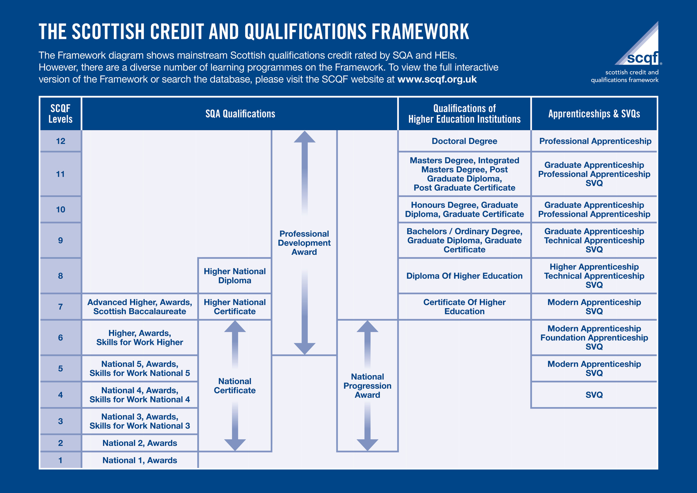
SCQF in
schools
Qualifications of Qualifications Scotland (formerly SQA)
Qualifications Scotland
qualifications up to SCQF
level 7 are offered in schools:
  Nat 4 = SCQF level 4
  Nat 5 = SCQF level 5
  Higher = SCQF level 6
  Advanced Higher = SCQF level 7
Notes:
Small group task and discussion
Pupils can open the Padlet and explore some of the examples of other qualifications on the SCQF. They can also search the SCQF Register at https://scqf.org.uk/the-framework/scqf-register/
Examples can include
Young Scot DigiKnow award,
Creative thinking,
Fuelchange,
Comedy and Confidence,
Filmaking,
Garment production,
Young STEM leaders,
Esports,
Mental Health and awareness,
Tenancy
Climate and Sustainability.

Slide 6



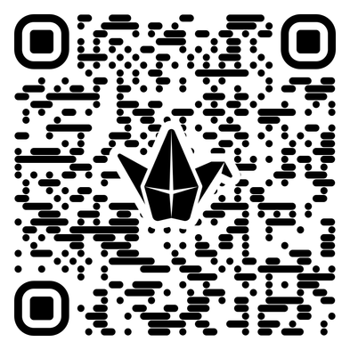
SCQF in
schools
Many other qualifications are available, including Skills for Work (SfW), National Progression Awards (NPAs), Apprenticeships, and Awards
Using the SCQF Padlet, can you find some other qualifications that could be offered in schools?

Slide 7
Ambassador Programme
  250+ schools across Scotland are involved in the programme
  Each school has a network of SCQF pupil ambassadors
  Schools want to introduce different qualifications
  Watch this video from St Andrew’s RC Secondary, in Glasgow, to see what they’re doing
  As you watch, think about who is involved, and the types of activities and qualifications mentioned
Notes:
Group task and discussion
Head teacher, subject teachers and pupil ambassadors are all speaking but it’s all pupils in the school involved in the activities
Pupils in the video are taking part in –
Computer games development
Computing science
Coding
Music theatre
Acting and performance
Criminology
Barista
Health and food tech

Slide 8
Why do I
need to know?
  It will help you make better informed decisions on what qualifications are right for you
  You can use the SCQF to map out where you want to go and which route will take you there
  Boost your confidence by having a better understanding of the level of learning you have achieved
  Pass on this knowledge to fellow pupils, parents and employers
Qualifications of Qualifications Scotland (formerly SQA)
Notes:
All qualifications on the SCQF are allocated a Level – A Higher is at SCQF level 6 but so is an NPA and Foundation Apprenticeship. One qualification is not better than the others, they are just different parts of pathways!
Pick the right qualifications for your pathway, whether that’s work, college, Uni or apprenticeships.
Check out the map to see some of the ways you can get to SCQF level 10 which includes Hons degree and Graduate apprenticeship.

Slide 9
Your role
and mission
  Simple! Help parents, carers, employers and fellow pupils to better understand qualifications and their value
  Watch this video from Lasswade High School Pupil Ambassadors and staff
  Think about what activities you might like to do as a group and discuss some ideas
Notes:
Group task after video
As pupil ambassadors, you can be as creative and innovative as you like!
Other pupils have used –
Social media channels or takeovers
Podcasts
Videos
Newsletters
Speaking at parents nights / course choice evenings
BGE assemblies
PSE classes
Anything!

Slide 10
Impact
  Employers will better understand your qualifications and skills
  Parents and carers will be able to help you to choose the right qualifications for your learning. They’ll also understand how your modern qualifications compare to theirs
  Pupils will recognise the value in different qualifications at different SCQF levels, and be confident about making subject choices in the future

Slide 11






What’s in
it for you?
Team
work
Communication
skills
Saltire
hours
Volunteering
Creativity
Managing
a project
Boost your CV/
personal statement
Leadership

Slide 12

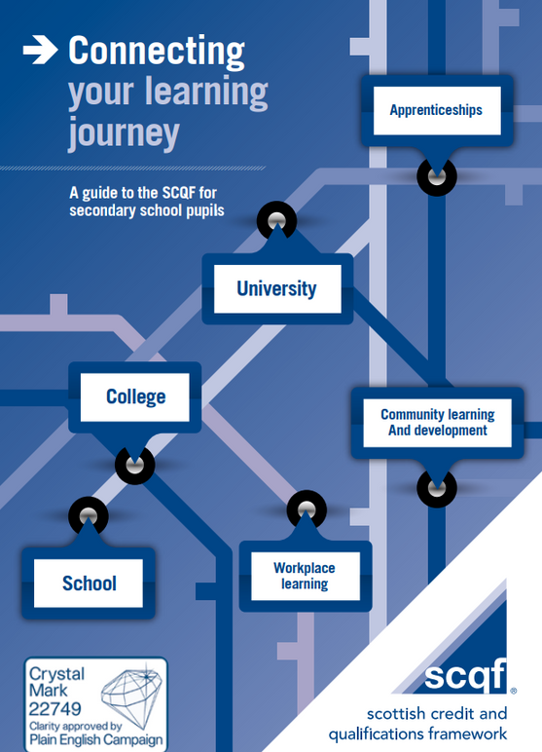
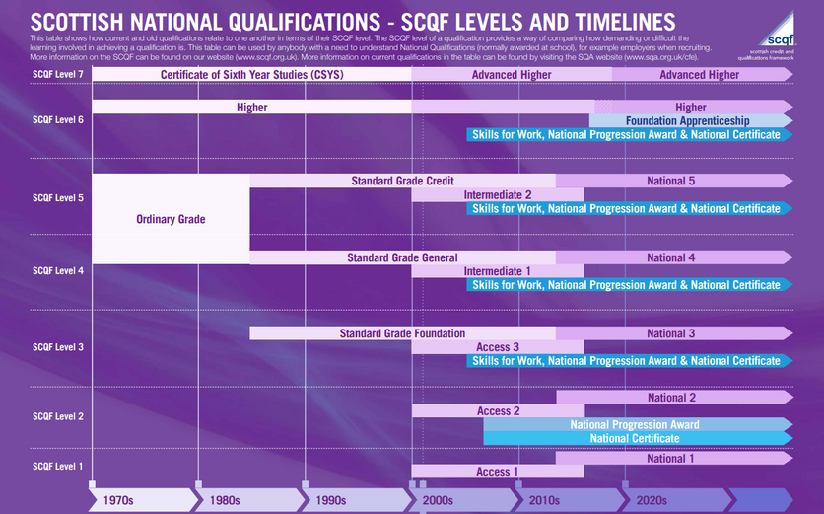
Resources
Click on image
Notes:
Summary of resources we can provide schools, parents and pupils.
Each resource image is hyperlinked and can be downloaded and printed if better.

Slide 13
Good luck!
  Keep in touch with us on Facebook, Instagram & Bluesky @SCQFPartnership
  Questions?
Be creative and confident to try new things.
Thanks for making a difference and volunteering your time!

